Slide 1

Hate Crime Data Challenge
Demarr Rice
Andrew La

Slide 2
What's a Hate Crime?
A crime motivated by prejudice
Assault
Intimidation
Burglary
On the basis of
Race
Religion
Sexual Orientation
Many other things

Slide 3
What can affect Hate Crime?
Education
Income
Unemployment

Slide 4
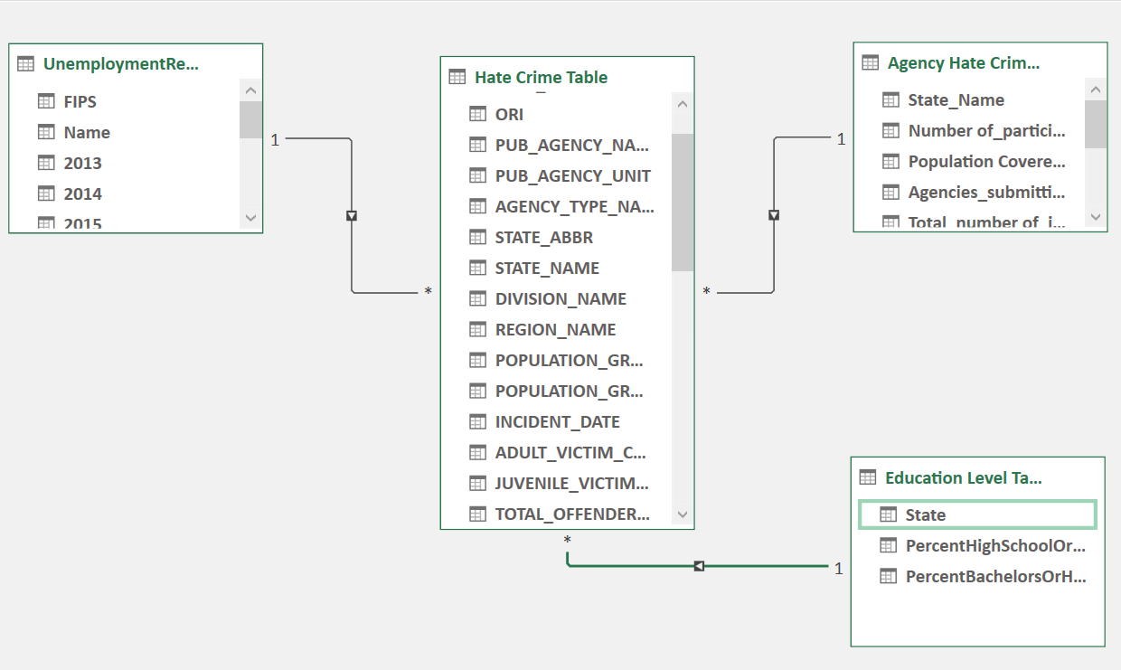
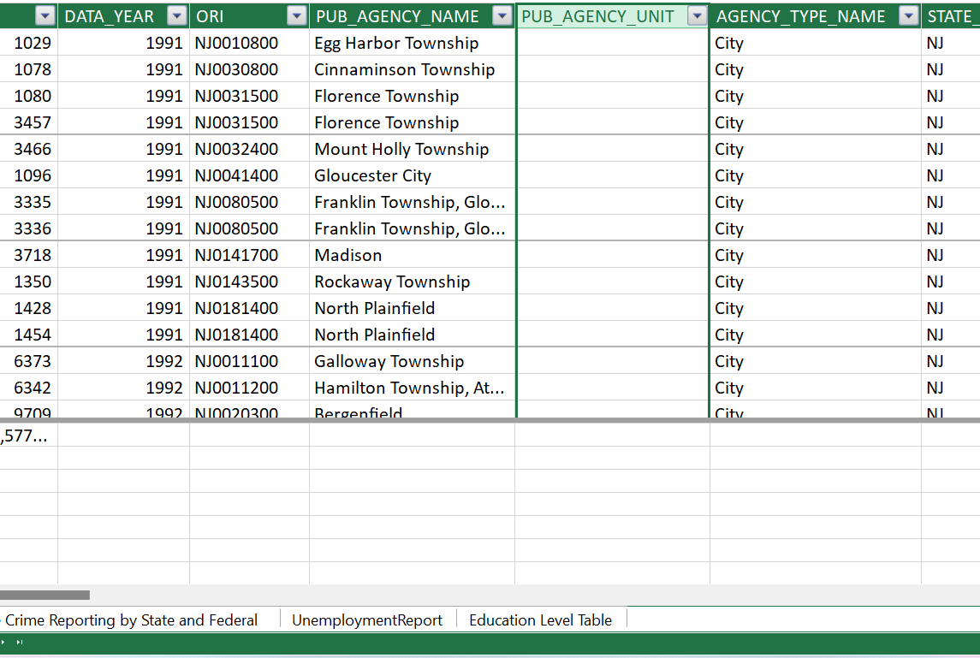
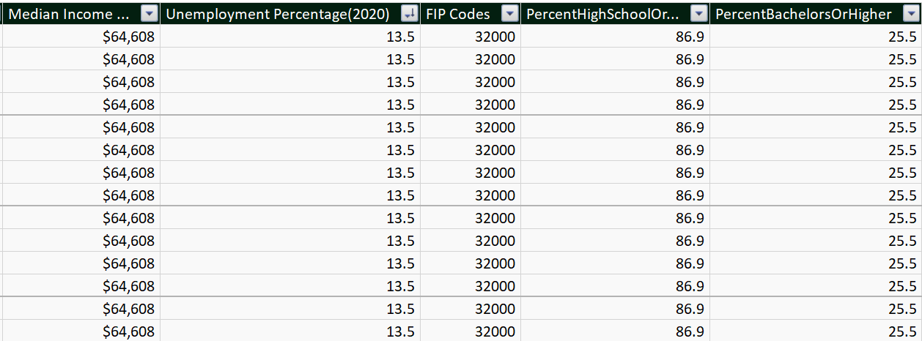
Data Tables
Primary Data Table
  Hate Crime Table
Dimension Tables
  Unemployment Report
  Agency Hate Crime Reporting by State and Federal
  Education Level
Relationships
  Connected by State Name

Slide 5

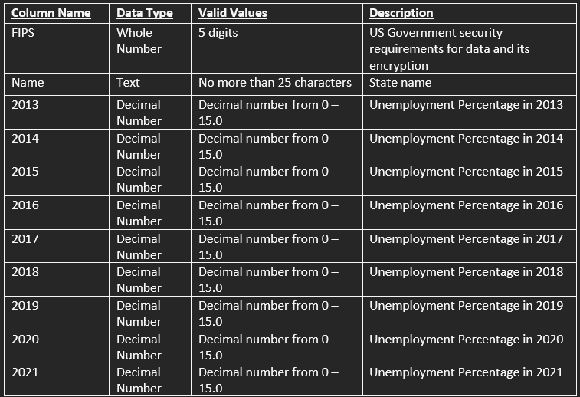
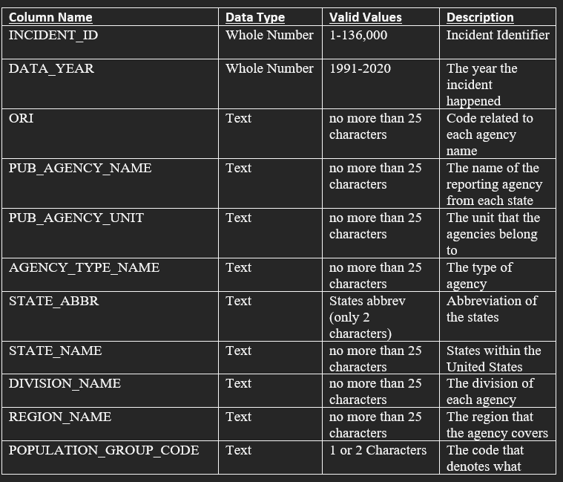



Metadata

Slide 6
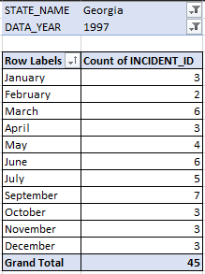
Research Questions
  Which state had the most hate crimes in 2020?
    New Jersey, 1,428 Incidents
  Which state has the highest hate crime per capita?
    District of Columbia, .0315%
  Does the State with the highest unemployment also have the highest rate of hate crime?
    This correlation is not accurate.
  How many hate crimes took place in Georgia, monthly, in 1997?
    In total, 45 documented hate crimes took place in 1997
  What kind of locations do most hate crimes take place?
    Residence and Homes, 65,093 Incidents

Slide 7
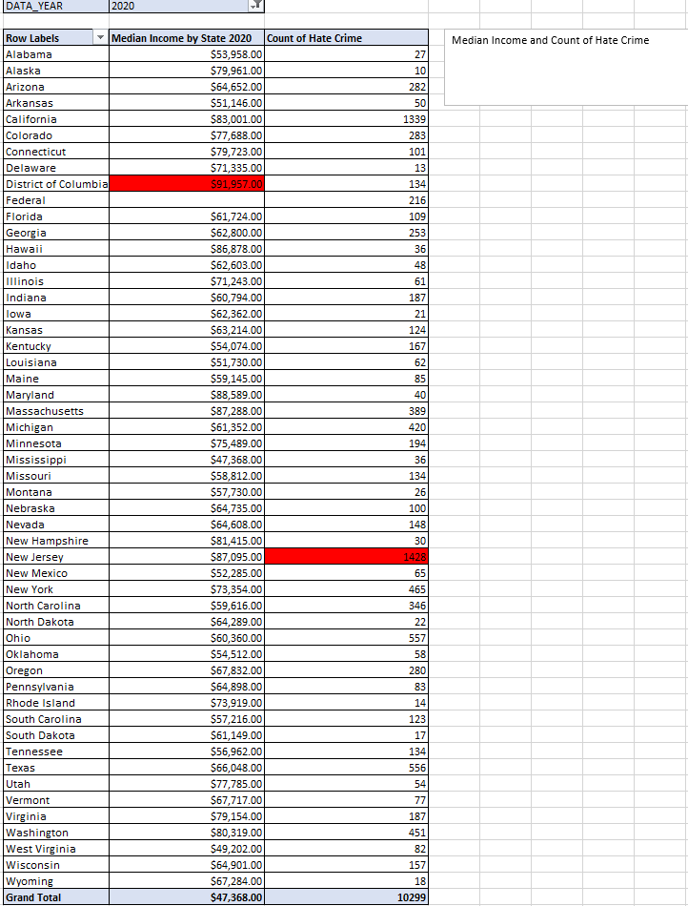
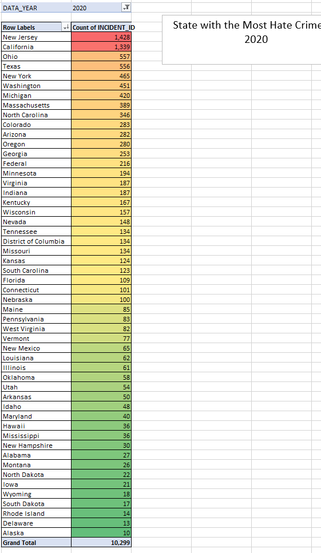
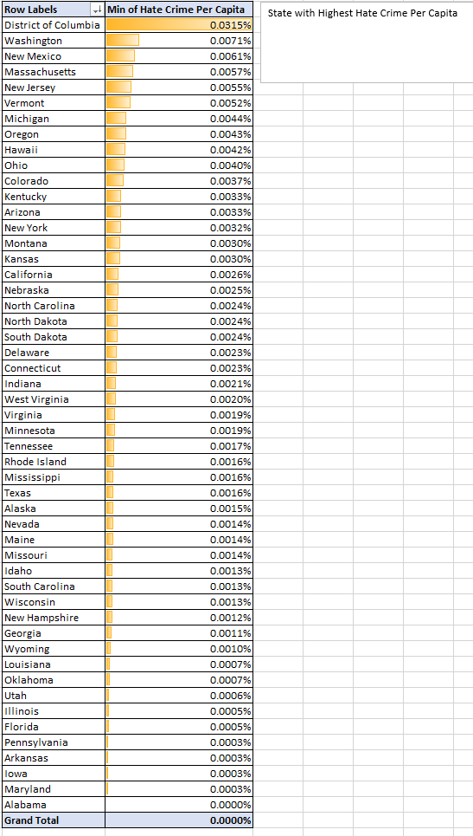
Pivot Tables

Slide 8
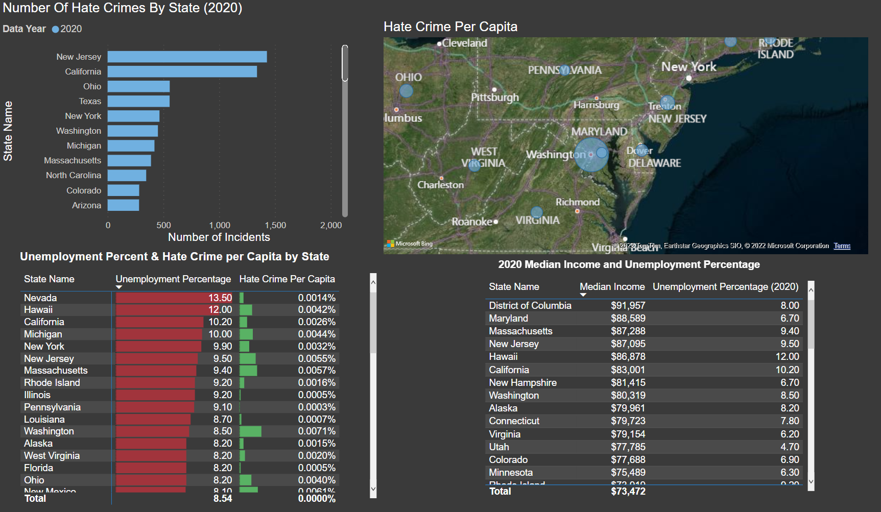
Power BI Dashboard

Slide 9
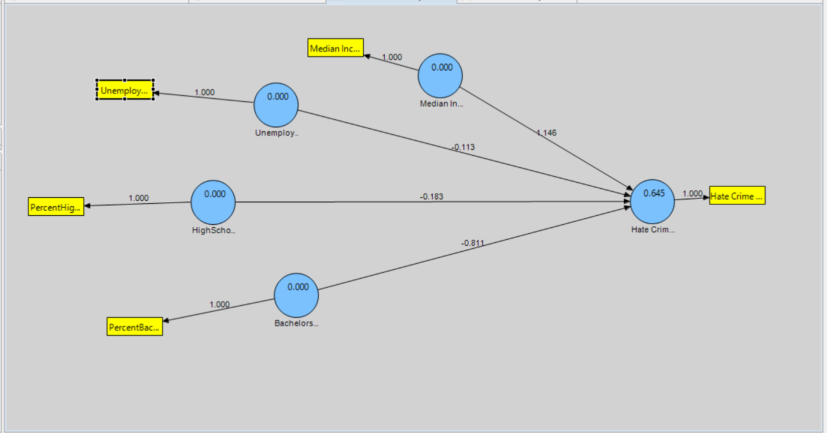
Regression

Slide 10
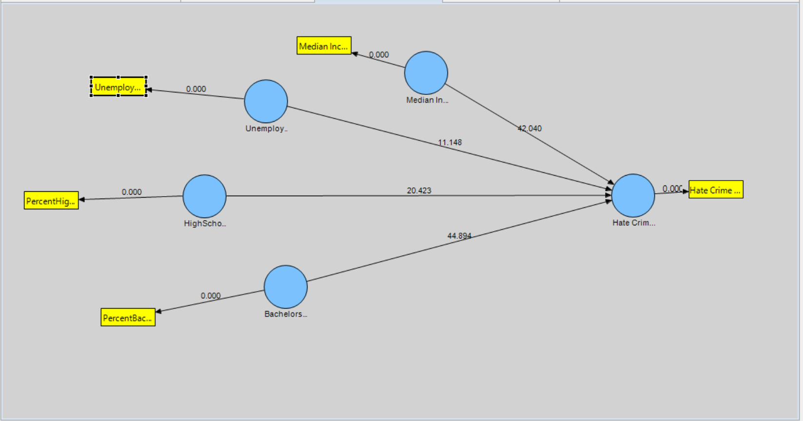
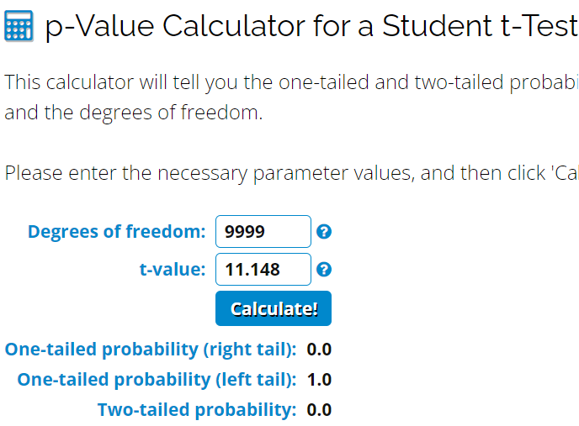
Bootstrap

Slide 11

Q & A

